Slide 1

The Adverse Childhood Experience Study (ACEs): Implications of Long-Term Effects
Randell Alexander MD PhD
University of Florida – Jacksonville

Slide 2

USEFUL FOR NOW, BUT THESE NEED TO GO AWAY
CPS
CPT system
Trauma informed communities
DV shelters
Need to prevent all of this instead!!

Slide 3

SAVE THE BRAIN – PREVENT ABUSE
GROW THE BRAIN - STIMULATION
Brains need both:
  Freedom from abuse
  Positive stimulation

Slide 4
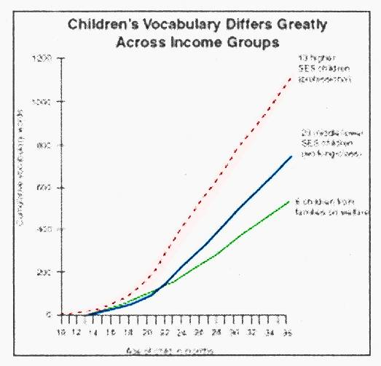
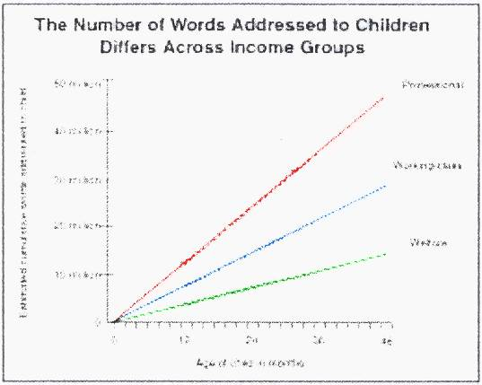
Left Behind By Kindergarten:
Children living in poverty average 15 IQ points below their peers.
Vocabulary at Age 3
Poor children: 525 words
Working class: 749 words
Professional: 1,116 words
By age 4, the average child in a poor family might have been exposed to 13 million fewer words than child in a working class family and 30 million fewer words than a child in a professional family.

Slide 5
The Evolution of Prevention
What Kind of Problem is it?
Justice &
Social Public
Service Health
Problem Problem
“It is time for critical thinking to formulate a new national public health priority, preventing child maltreatment and promoting child well treatment.”
Surgeon General Richard H. Carmona, MD MPH – March 2005
Notes:
As science linked CM and these health risk behaviors, diseases, and injuries, a shift has occurred over recent years from thinking about CM and our response to is as primarily a law enforcement and social service problem to also a public health problem.

Slide 6
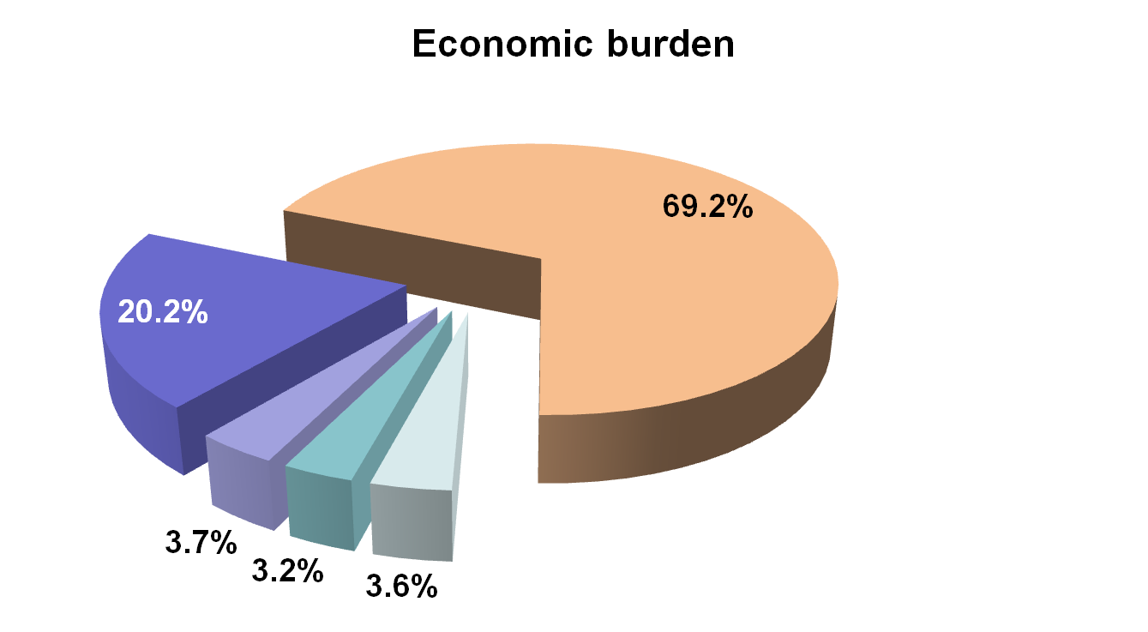
Lifetime Economic Burden
of Child Maltreatment: $124 billion in 2008
Productivity losses
Health care costs
Special education costs
Criminal justice costs
Child welfare costs
(Fang X, et al. Child Abuse Negl (2012)
6
Notes:
CDC has recently estimated the economic toll of child maltreatment.
The total lifetime economic burden resulting from new cases of fatal and nonfatal CM in the US in 2008 is estimated to exceeds 121 billion.
About 20% of this estimate is attributable to health care costs, 69% to productivity losses, and the rest to the costs of child welfare, criminal justice and special education.
This estimate is based on confirmed reports of CM to CPS agencies. If one uses less conservative estimates of the magnitude of CM in the US this estimates balloons to over half a trillion dollars.
9
6

Slide 7
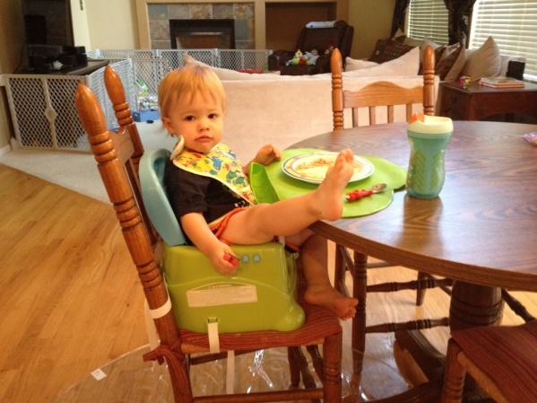
WHAT HAPPENS IF WE DON’T PREVENT ABUSE?
FOUR AREAS OF RESEARCH CONVERGENCE
ACES STUDY
NEUROSCIENCE
BRAIN IMAGING
TELOMERES

Slide 8
#1

Slide 9
ACES

Slide 10
The Influence of Child Maltreatment Throughout Life
Health-risk Behaviors
Sexual promiscuity Sexual perpetration Alcohol abuse
Illicit/injected drug use
Smoking
Behavior problems
Mental/Social Problems
PTSD
Depression
Anxiety
Eating disorders Academic achievement
Unwanted pregnancy
Obesity
Revictimization
Disease and Injury Conditions
Ischemic heart disease
Diabetes
Stroke
Cancer
Suicide
Skeletal fractures
Chronic bronchitis/
emphysema
STDs (e.g., HIV)
Hepatitis
Child Maltreatment

Slide 11
Adverse Childhood Experiences and their Relationship to Adult Health and Well-being
A collaborative effort of Kaiser Permanente and The Centers for Disease Control and Prevention
www.acestudy.org
Vincent J. Felitti, M.D.
Robert F. Anda, M.D.
Notes:
1

Slide 12
The Adverse Childhood Experiences (ACE) Study
The largest study of its kind ever done to examine the health, social, and economic effects of adverse childhood experiences over the lifespan (18,000 participants)
Average age = 57 years old
Notes:
2

Slide 13
What do we mean by Adverse Childhood Experiences?
Experiences that represent medical and
social problems of national importance.
-childhood abuse and neglect
-growing up with domestic violence,
substance abuse or mental illness in
the home, parental loss, or crime
Notes:
2

Slide 14
Categories of Adverse
Childhood Experiences
Category
Prevalence (%)
Abuse, by Category
Psychological (by parents) 11%
Physical (by parents) 11%
Sexual (anyone) 22%
Household Dysfunction, by Category
Substance Abuse 26%
Mental Illness 19%
Mother Treated Violently 13%
Imprisoned Household Member 3%

Slide 15
ACE Score
Total number of ACE that each participant reported
Used to assess negative experiences during childhood
Example: Experiencing physical abuse as a child is an ACE score of one. Experiencing physical abuse plus witnessing IPV is an ACE store of two.

Slide 16
Adverse Childhood Experiences Score
Number of categories of adverse childhood experiences
are summed …
ACE score Prevalence
0 48%
1 25%
2 13%
3 7%
4 or more 7%
More than half have at least one ACE
If one category of ACE is present, there is an 84% likelihood of additional categories being present.
Notes:
7

Slide 17

HEALTH CONSEQUENCES

Slide 18
SEX

Slide 19
Number of Adverse Childhood Experiences
and Teen Sexual Behaviors

Slide 20
ACE Score and HIV Risks
Notes:
2

Slide 21
DRUGS

Slide 22
Childhood Experiences vs.
Adult Alcoholism
4+
3
2
1
0

Slide 23
Relationship Between Number of Adverse Childhood Experiences and Smoking Behaviors and Smoking-Related Lung Disease

Slide 24
ACE Score vs. Intravenous Drug Use
N = 8,022 p<0.001

Slide 25
Estimates of the Population Attributable Risk* of ACEs for Selected Outcomes in Women
*That portion of a condition attributable to specific risk factors

Slide 26
MENTAL HEALTH

Slide 27
Childhood Experiences
Underlie Chronic Depression

Slide 28
Childhood Experiences
Underlie Attempted Suicide
4+
3
2
1
0

Slide 29
ACE Score and Hallucinations
Abused
Alcohol
or Drugs
Ever Hallucinated* (%)
ACE Score
*Adjusted for age, sex, race, and education.

Slide 30
Estimates of the Population Attributable Risk* of ACEs for selected outcomes in women
*That portion of a condition attributable to specific risk factors

Slide 31
Childhood Experiences Underlie Rape
4+
3
2
1
0

Slide 32
ACE STUDY FINDINGS
As ACE score goes up, so does risk for:
  Smoking
  Organic disease
  Adult alcoholism
  Depression and suicide attempts
  Having 50+ lifetime sexual partners
  STD’s and Rape (from 5% to 33%)
  Hallucinations
  Domestic Violence
  Addictions
  Dying early
  Job Problems and lost time from work
Felitti VJ, Anda RF, Nordenberg D, Williamson DF, Spitz AM, Edwards V, Koss MP, et al JS. The relationship of adult health status to childhood abuse and household dysfunction. American Journal of Preventive Medicine. 1998;14:245-258.

Slide 33
Adverse Childhood Experiences Reported by Adults
Five States, 2009
First published report to document prevalence of ACEs in population-based representative sample from multiple states stratified by demographic characteristics, including sex, age, education, and race/ethnicity.
Approximately 59% reported one or more ACEs
These BRFSS estimates are similar to the findings in the Kaiser-CDC ACE study (2) and similar research, including study in Texas
  CDC MMWR, December 17, 2010/59(49); 1609-1613
Notes:
33

Slide 34
Adverse Childhood Experiences determine the likelihood of the
10 most common causes of death in the US
Top 10 Risk Factors: smoking, severe obesity, physical inactivity, depression, suicide attempt, alcoholism, illicit drug use, injected drug use, 50+ sexual partners, history of STD

Slide 35

With an ACE Score of 0
The majority of adults have few, if any, risk factors for these diseases

Slide 36
However, with an ACE Score of 4 or more
The majority of adults have multiple risk factors for these diseases or the diseases themselves

Slide 37
Many chronic diseases in adults are determined decades earlier, in childhood

Slide 38
Evidence from ACE Study
Adverse childhood experiences are the most basic cause of
* health risk behaviors
* morbidity
* disability
* mortality
* healthcare costs
Notes:
Well hidden by time, shame, secrecy, and social taboo.

Slide 39
ACES AND PREVENTION

Slide 40
Frieden’s pyramid adapted to child maltreatment
Greater
effort
Examples
Smallest
Impact
Parent training
Counseling
& Education
Screen and refer for IPV, depression or substance abuse
Clinical
Interventions
Home visitation
Child-Parent Centers
Long-lasting
protective interventions
Built environment
Positive Community
Norms
Smaller
Effort
Changing the context
Make healthy choices the “default” or easiest choice
Poverty, education,
housing, inequality
Largest
Impact
Socioeconomic Factors
Frieden’s pyramid AJPH 2010;100(4): 590-595

Slide 41




Vision for DVP’s
Child Maltreatment Prevention Work
Assuring safe, stable, nurturing relationships and environments
for all children
Notes:
Why focus on safe, stable, nurturing relationships and environments: history of development
An important role of public health is to assure safe, stable, nurturing relationships and environments for all children
Essentials for Childhood: the broad “umbrella” for all of our child maltreatment work

Slide 42
SOCIAL NORMS CHANGE

Slide 43
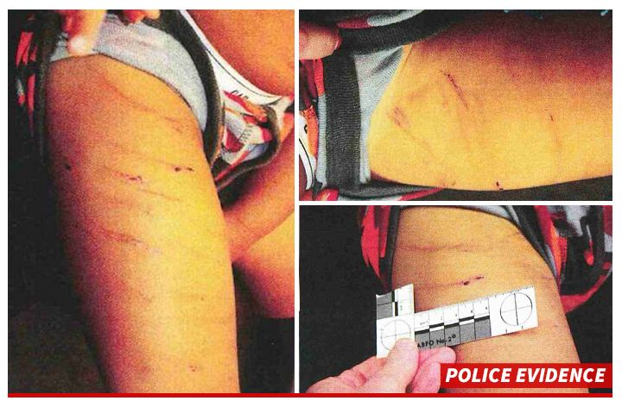
OPPORTUNITY FOR
NORMS CHANGE: CORPORAL PUNISHMENT
Adrian Peterson – NFL
Sparking a debate about corporal punishment in USA
Is your organization reaching out to NFL?
AVA is trying

Slide 44
OPPORTUNITY FOR
NORMS CHANGE: CORPORAL PUNISHMENT
In the following 38 countries, children are protected by law from all corporal punishment (most recent first):
Bolivia (2014)
Brazil (2014)
Malta (2014)
Honduras (2013)
TFYR Macedonia (2013)
South Sudan (2011)

Slide 45
OPPORTUNITY FOR
NORMS CHANGE: CORPORAL PUNISHMENT
Albania (2010)
Congo, Republic of (2010)
Kenya (2010)
Tunisia (2010)
Poland (2010)
Liechtenstein (2008)
Luxembourg (2008)
Republic of Moldova (2008)
Costa Rica (2008)
Togo (2007)
Spain (2007)
Venezuela (2007)

Slide 46
OPPORTUNITY FOR
NORMS CHANGE: CORPORAL PUNISHMENT
Uruguay (2007)
Portugal (2007)
New Zealand (2007)
Netherlands (2007)
Greece (2006)
Hungary (2005)
Romania (2004)
Ukraine (2004)
Iceland (2003)
Turkmenistan (2002)
Germany (2000)
Israel (2000)
Bulgaria (2000)
Croatia (1999)
Latvia (1998)
Denmark (1997)

Slide 47
OPPORTUNITY FOR
NORMS CHANGE: CORPORAL PUNISHMENT
Cyprus (1994)
Austria (1989)
Norway (1987)
Finland (1983)
Sweden (1979)

Slide 48
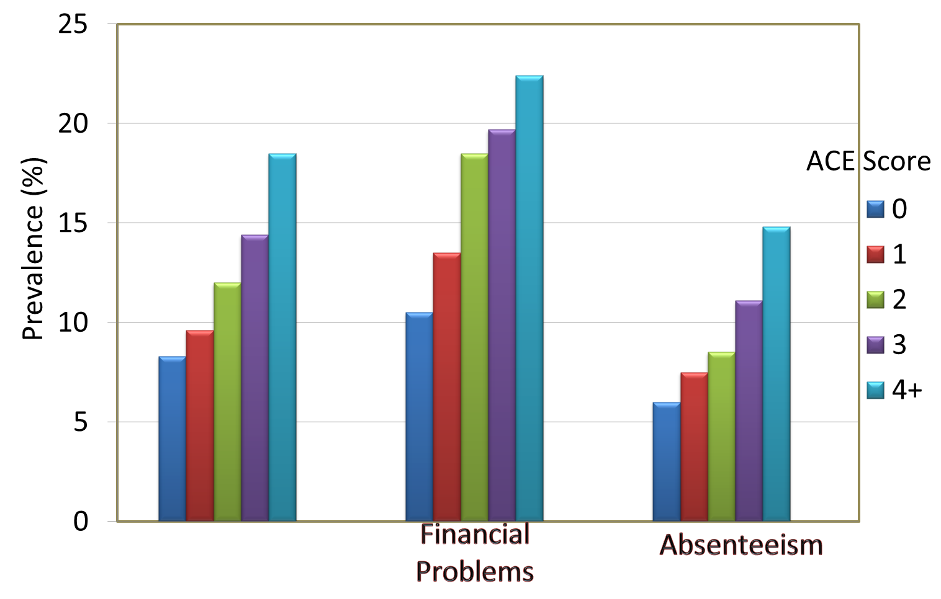
ACE Score and Work Problems
Job Problems
Notes:
Analyzed data for ACE study from 9,633 currently employed adult members of Kaiser Foundation Health Plan in San Diego
Strong graded relations found between ACE Score and each measure of impaired worker performance
Each of the ACEs was associated with an increased likelihood of:
job problems
financial problems, and
absenteeism

Slide 49
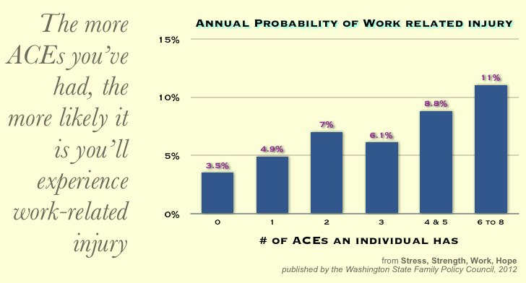

Slide 50
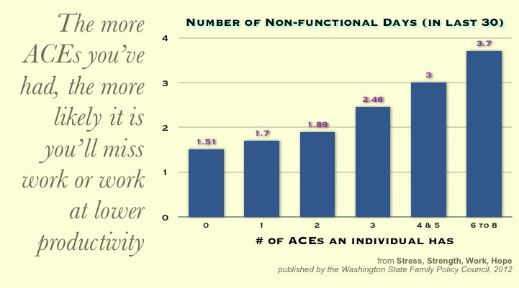

Slide 51

NEW ZEALAND
SOVEREIGN INSURANCE

Slide 52

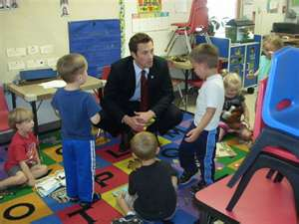
IMAGINE if……..
More employers offered on-site childcare and/or childcare benefits
To help reduce parental stress and allow parents to check in during day

Slide 53
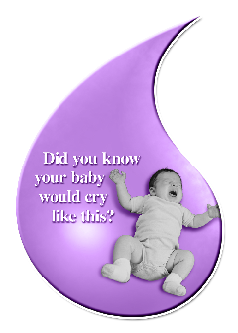
IMAGINE If……..
Businesses helped reinforce prevention messages…….
With “floor talkers” on coping with infant crying
Notes:
53

Slide 54
IMAGINE if……
When business leaders talk with policy makers, they use the opportunity to talk about the impact of ACEs and the importance of safe, stable, nurturing relationships and communities

Slide 55
#2

Slide 56
BRAIN DEVELOPMENT
National Scientific Council on the Developing Child www.developingchild.net
Some of the top neuroscientists have also come to appreciate how brains:
Develop, and
Develop differently depending upon the environment they are exposed to

Slide 57
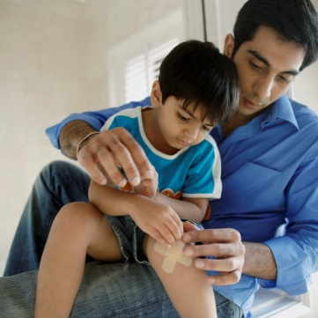

3 CATEGORIES OF STRESS
Positive stress
Tolerable stress
Toxic stress

Slide 58

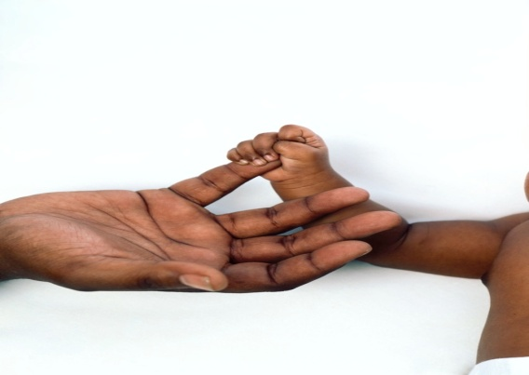
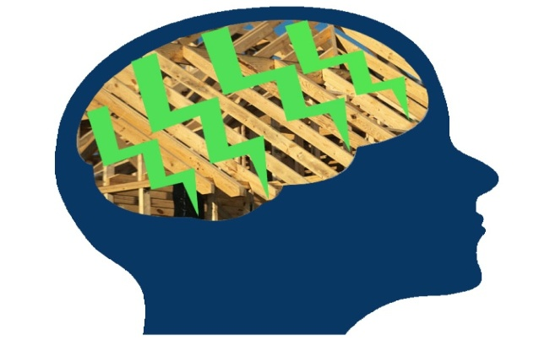
3 Core Concepts in Early Development
Experiences build brain architecture
“Serve and Return” interaction shapes brain circuitry
Toxic stress derails healthy development
http://www.developingchild.harvard.edu
Notes:
58

Slide 59
BRAIN DEVELOPMENT
Early experiences are built into our bodies and brains--- for better or for worse
Healthy development in the early years provides the building blocks for:
  educational achievement
  economic productivity
  responsible citizenship
  lifelong health
  strong communities
  successful parenting of the next generation
http://www.developingchild.harvard.edu
Notes:
59

Slide 60

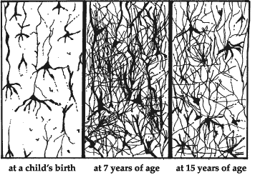
Synaptic Density
700 new synapses (neural
connections) every second
SOURCE: Harvard Center on the Developing Child
Notes:
NOTES TO PRESENTERS:
This slide shows the importance of supporting healthy brain development, particularly in younger children.
TALKING POINTS FOR PRESENTERS:
The basic architecture of the brain is constructed through an ongoing process that begins before birth and continues into adulthood. During the first few years of life, 700 new synapses (neural connections) are formed every second. After a period of rapid proliferation, connections are reduced through a process called pruning, so that brain circuits can become more efficient. Early experiences affect the nature and quality of the brain’s developing architecture by determining which circuits are reinforced and which are pruned through lack of use. Some people refer to this as “use it or lose it.”
60

Slide 61
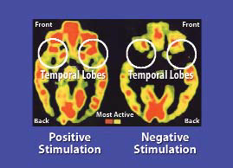
Brain activity of a normal five-year-old child (left)
and a five-year-old institutionalized orphan neglected in infancy (right).
Notes:
61

Slide 62
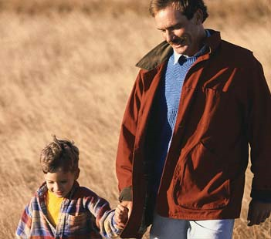
SSNRs : Influence Early Brain Development and Buffer Adverse Childhood Experiences
Healthy development depends on the quality and reliability of a young children’s relationships with the important people in their lives
Nurturing, responsive, and individualized interactions build healthy brain architecture that provides a strong foundation for future learning, behavior, and health
SSNRs can provide a buffer for ACE
Notes:
For example, when children experience normal and tolerable stress in their lives, they are better able to navigate through that if they have nurturing, responsive interactions with key people in their lives.
62

Slide 63
#3

Slide 64
SEXUAL ABUSE AND THE BRAIN
Children may be more susceptible than adults to cellular microenvironments and impact on brain development
High rate of PTSD (42% to 90%)
[Physical abuse rate of PTSD may be 50%]
Limbic-hypothalamic-pituitary-adrenal axis is at risk (may be “over sensitive”)
De Bellis, M. Spratt E, Hooper S. Neurodevelopmental Biology Associated with Childhood Sexual Abuse. JCSA 2011.

Slide 65
SEXUAL ABUSE AND THE BRAIN
Increased sensitivity of the locus ceruleus/SNS/chatecholamine system?
Responsible for high heart rate, blood pressure, other effects
Becomes dysregulated?

Slide 66
SEXUAL ABUSE AND THE BRAIN
Serotonin may become low in the prefrontal cortex – associated with depression, suicidal behaviors, impulsivity
May lead to “learned helplessness”

Slide 67
SEXUAL ABUSE AND THE BRAIN
Neuroimaging of adults supports the concept that medial prefrontal regions responsible for executive functions are hyporesponsive when abused as children
Amygdala is hyperresponsive
Corpus callosum is decreased (males more than females?)
Smaller overall brain volume (e.g. 8%) as adults

Slide 68
#4

Slide 69
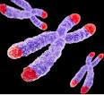
TELOMERES
Telomeres are the ends of DNA strands which are shortened with each cellular division.
With each replication, telomeres shorten until the “Hayflick limit” is reached and the cell enters senescence.
Telomeres are thought to be a sign of cellular aging (and perhaps overall aging of the organism).

Slide 70
EXPOSURE TO VIOLENCE DURING CHILDHOOD IS ASSOCIATED WITH TELOMERE EROSION FROM 5 TO 10 YEARS OF AGE: A LONGITUDINAL STUDY
Same children examined for telomere erosion between 5 and 10 years of age
Physical abuse caused more erosion
Combination of physical abuse, exposure to domestic violence, or bullying caused the most erosion
Children will have decreased life span, earlier diseases
Shalev I, Moffitt TE, Sugden K, Williams B, Houts RM, Danese A, Mill J, Arseneault l, Caspi A. Molecular Psychiatry 2012. doi:10.1038/mp.2012.32.

Slide 71

FOUR LINES OF
CONVERGENCE
Not only does abuse alter which neurons are selected, how different parts of the brain develop, and how neuro-hormonal pathways are altered but now it can be seen that it leaves its very footprints deep in the cells.
Abuse creates different children

Slide 72
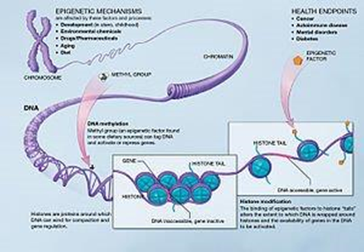
EPIGENETICS
;
Epigenetics is the study of heritable changes in gene activity that are not caused by changes in the DNA sequence

Slide 73
ADULTS TELL YOU ABOUT THEIR BRAINS

Slide 74
ADULTS TELL YOU ABOUT THEIR BRAINS
How people react gives you clues about their life

Slide 75

ADULTS TELL YOU ABOUT THEIR BRAINS
Example 1:
  A guy goes into a bar and gets into a discussion with another guy
  That guy suddenly hits him without warning
What kind of brain behavior is he showing?
Limbic-hypothalamic-pituitary-adrenal over-reactivity?

Slide 76

ADULTS TELL YOU ABOUT THEIR BRAINS
Example 2:
  A woman says that her 3 year old will not mind and she needs to hit him, but it doesn’t work
  You give alternatives, but she insists nothing works and doesn’t really try
What kind of brain behavior is she showing?

Slide 77
CHILDREN TELL YOU ABOUT THEIR BRAINS

Slide 78
CHILDREN TELL YOU ABOUT THEIR BRAINS
They experience trauma
  Prenatal substance exposure, mother’s stress chemicals
  Neglect
  Physical abuse
  Sexual abuse
  Witnessing IPV, bullying

Slide 79
Response to Trauma: Bodily Functions
FUNCTION | CENTRAL CAUSE | SYMPTOM(S)
Sleep | Stimulation of reticular activating system | 1. Difficulty falling asleep 2. Difficulty staying asleep 3. Nightmares
Helping foster and adoptive families cope with trauma. AAP, 2013 http://www.aap.org/en-us/advocacy-and-policy/aap-health-initiatives/healthy-foster-care-america/Documents/Guide.pdf

Slide 80
Response to Trauma: Bodily Functions
Eating | Inhibition of satiety center, anxiety | 1. Rapid eating 2. Lack of satiety 3. Food hoarding 4. Loss of appetite
Helping foster and adoptive families cope with trauma. AAP, 2013 http://www.aap.org/en-us/advocacy-and-policy/aap-health-initiatives/healthy-foster-care-america/Documents/Guide.pdf

Slide 81
Response to Trauma: Bodily Functions
Toileting | Increased sympathetic tone, increased catecholamines | 1. Constipation 2. Encopresis 3. Enuresis 4. Regression of toileting skills
Helping foster and adoptive families cope with trauma. AAP, 2013 http://www.aap.org/en-us/advocacy-and-policy/aap-health-initiatives/healthy-foster-care-america/Documents/Guide.pdf

Slide 82
RESPONSE TO TRAUMA: BEHAVIORS
Category | More common with | Response | Misidentified as and/or comorbid with
Dissociation (Dopaminergic) | Females Young children Ongoing trauma/pain Inability to defend self | Detachment Numbing Compliance Fantasy | Depression ADHD inattentive type Developmental delay
Helping foster and adoptive families cope with trauma. AAP, 2013 http://www.aap.org/en-us/advocacy-and-policy/aap-health-initiatives/healthy-foster-care-america/Documents/Guide.pdf

Slide 83
RESPONSE TO TRAUMA: BEHAVIORS
Category | More common with | Response | Misidentified as and/or comorbid with
Arousal (Adrenergic) | Males Older children Witness to violence Inability to fight or flee | Hypervigilance Aggression Anxiety Exaggerated response | ADHD ODD Conduct disorder Bipolar disorder Anger Management difficulties
Helping foster and adoptive families cope with trauma. AAP, 2013 http://www.aap.org/en-us/advocacy-and-policy/aap-health-initiatives/healthy-foster-care-america/Documents/Guide.pdf

Slide 84
THERAPY –WHAT IS IT?

Slide 85
THERAPISTS ARE BRAIN CHANGERS
If you go into a room with a therapist and come out with the exact same brain
In this universe – nothing happened

Slide 86
THERAPISTS ARE BRAIN CHANGERS
Therapy changes brains
  Uses adaptation to diminish neuroendocrine responsiveness to a stimuli (e.g. touching another human being is not as associated with hurt)
  Establishes techniques that release less toxic chemicals to stress situations

Slide 87

THERAPISTS ARE BRAIN CHANGERS
Mentalistic terms are ok, but they reflect actual physical underpinnings
21st century therapists envision the brain they are seeing and treating – if not, you are in the previous century

Slide 88
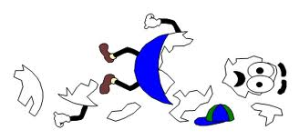
ABUSE CHANGES THE BRAIN
Primary prevention is vital
All of us might help for what has occurred, but often we can’t do enough

Slide 89
