Slide 1

Teen Dating Violence
Your Friends, Yourself, Your Children
Child Abuse Council of Santa Clara County
https://www.sccgov.org/sites/cac/Pages/cac.aspx
10-2-15 - Overfelt High School

Slide 2

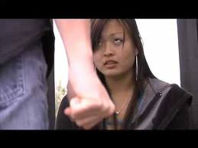
Healthy/unhealthy relationships…
How are they different?

Slide 3
Defining abuse
“Abuse is a repetitive pattern of behaviors to maintain power and control over an intimate partner.”
“These are behaviors that physically harm, arouse fear, prevent a partner from doing what they wish or force them to behave in ways they do not want.”
--The National Domestic Violence Hotline

Slide 4
What is dating violence?
Dating violence is controlling, abusive, and aggressive behavior in a romantic relationship. It can happen in straight or gay (or other) relationships. It can include verbal, emotional, physical, or sexual abuse, or a combination.
--National Center for Victims of Crime

Slide 5
BOYS, GIRLS, AND OTHER GENDER IDENTITIES, AND ALL SEXUAL ORIENTATIONS ARE AFFECTED
Usually boys do the most serious forms of dating abuse and sexual abuse, and usually girls are more frightened and traumatized.
But remember…it can happen to boys and those of all gender identities & sexual orientations.

Slide 6
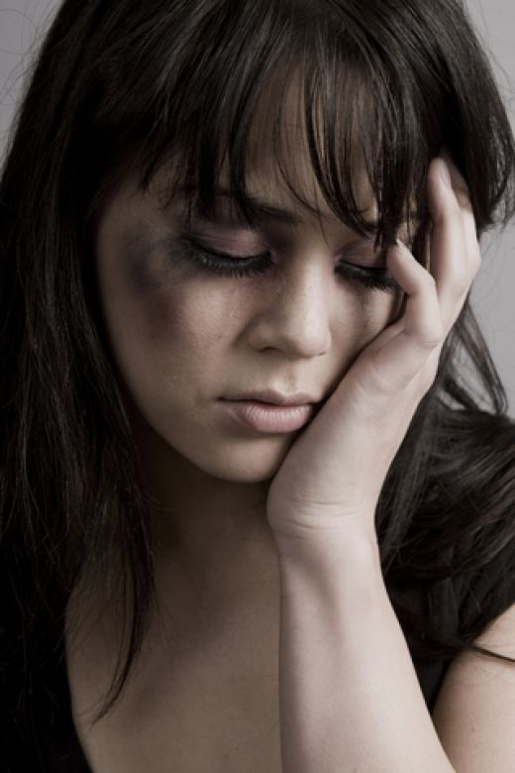
PHYSICAL ABUSE
Hitting
Shoving
Shaking
Scratching
Pushing
Pulling hair
Pinching
Choking (STRANGLING)
Biting
Threatening to/using a weapon
Notes:
This is what comes to mind for most people when they think of abusive relationships, but it’s not the only kind of abuse.

Slide 7
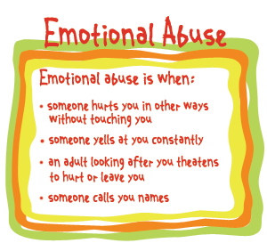
EMOTIONAL/PSYCHOLOGICAL ABUSE
Attacking your self-esteem
threatening
terrorizing
name calling,
shaming,
bullying,
embarrassing on purpose,
isolating from friends and family.
Notes:
This is the most common type of abuse. It can be harder to get help when you’re experiencing this kind of abuse because it leaves no obvious marks, and many people whose partners abuse them this way may try to rationalize the behavior or dismiss it.
Extended list of examples:
Ignoring date’s feelings
Insulting date’s feelings or beliefs
Acting in intimidating way
Using sexually derogatory names
Calling date names
Isolating date from others
Driving recklessly to scare date
Displaying inappropriate anger
Damaging personal property
Scaring date
Keeping date from leaving
Putting down family and friends
Humiliating date in public or private
Purposely injuring an animal/her pet to intimidate/terrorize/punish
Telling lies
Threatening self-harm*
Aggression can turn towards partner very quickly

Slide 8
SEXUAL ABUSE
Forcing a partner to engage in a sex act when he or she does not or cannot consent - can be physical or nonphysical, like threatening to spread rumors if a partner refuses to have sex.
Using drugs/alcohol to take advantage of you
Touching you in unwanted ways
Ignoring “NO” if you change your mind about wanting sex
Refusing to use protection (e.g. condoms)
Notes:
Sexual abuse is the least common type of abuse in teen relationships, but that does not mean it isn’t serious. Because of lack of experience and social pressure, teens may feel like they have to give in to their partner’s sexual requests if they don’t want to be lose social status or be alone.

Slide 9
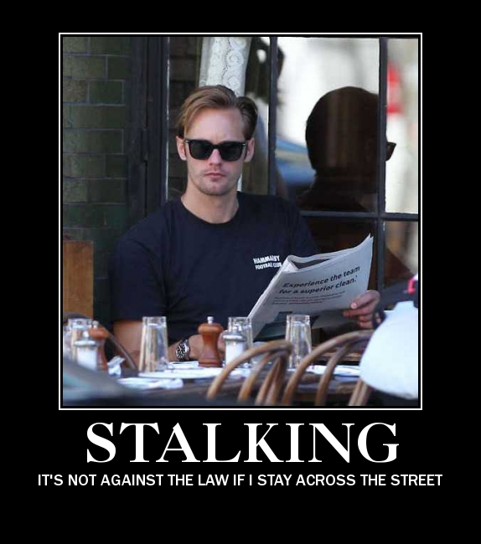
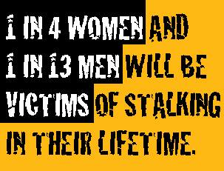
STALKING
A pattern of harassing or threatening tactics that are unwanted and cause fear in the victim.
Can be physical or technological, e.g., following or spying on you.

Slide 10
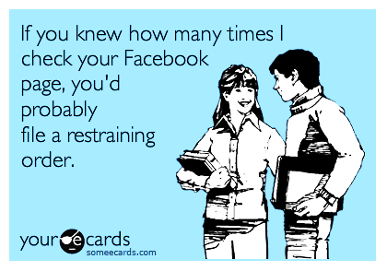
TECHNOLOGICAL ABUSE
“He went through my Facebook friends and unfriended anybody who was a guy because he didn’t want me talking to them.”
Notes:
This picture may be funny, but the reality is not.

Slide 11
TECHNOLOGICAL ABUSE/STALKING
Monitoring your physical whereabouts through social media, cell phone, etc.
Hacking into your accounts to read your messages
Threatening to spread personal information about you online
Constantly checking up on you through text, email, IM, etc.

Slide 12
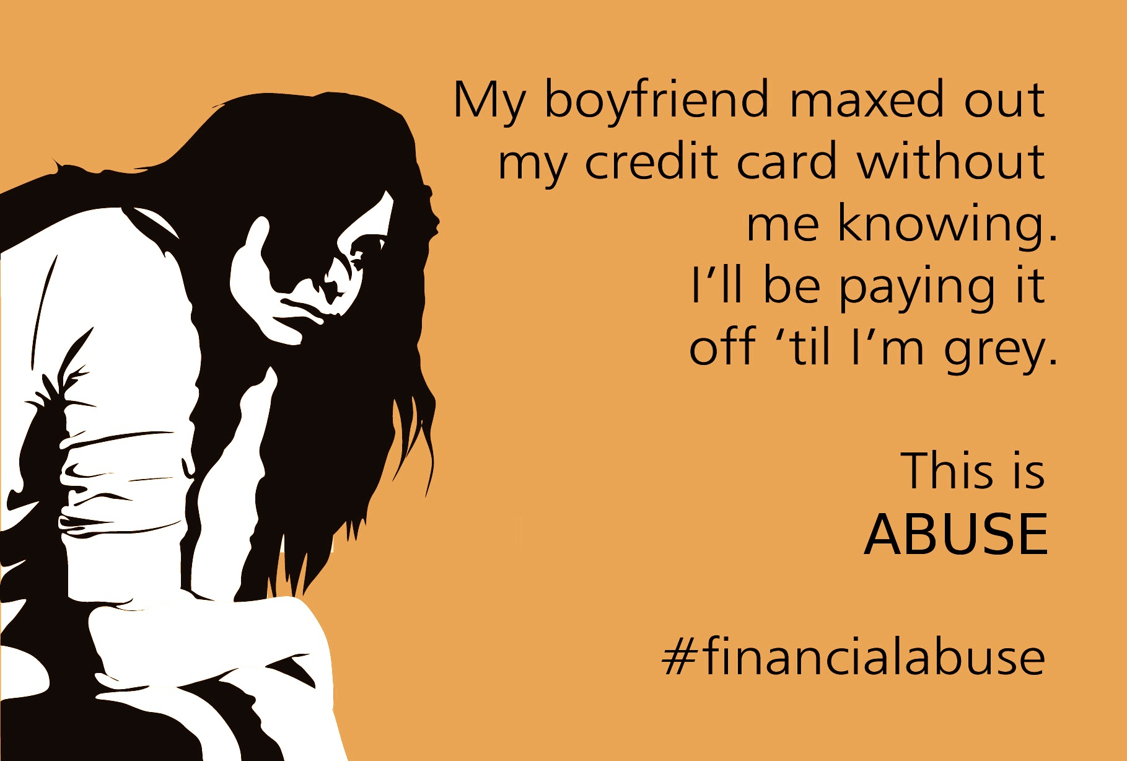
FINANCIAL ABUSE
Stealing your money or things.
Making you pay for everything
Borrowing money and not returning it
Guilt tripping you to get your money
Making you feel like owe him or her because they bought you things.
Notes:
Financial abuse involves using money as a tool to control and later coerce the victim.

Slide 13
HOW COMMON IS TEEN DATING VIOLENCE?
About 9% of high school students report being hit, slapped, or physically hurt on purpose by a boyfriend or girlfriend in the previous 12 months (CDC).
That’s 1.5 million (loveisrespect.org)

Slide 14
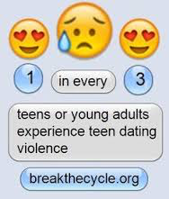
HOW COMMON IS TEEN DATING VIOLENCE?
(loveisrespect.org)
Over the Course of the teenage years.

Slide 15
HOW DOES DATING VIOLENCE AFFECT HEALTH? (CDC)
Depression and anxiety
Drug/alcohol abuse, and smoking
Behavior problems including antisocial behavior
Thoughts of suicide
[But any kind of significant trauma that is unresolved can result in a far greater range of emotional, behavioral, cognitive (academic), and social/relationship problems, and can have a negative effect on health throughout life.

Slide 16
Dating Relationships
What do healthy ones look like?
What do abusive ones look like?
And what can you do if you find yourself in one!

Slide 17
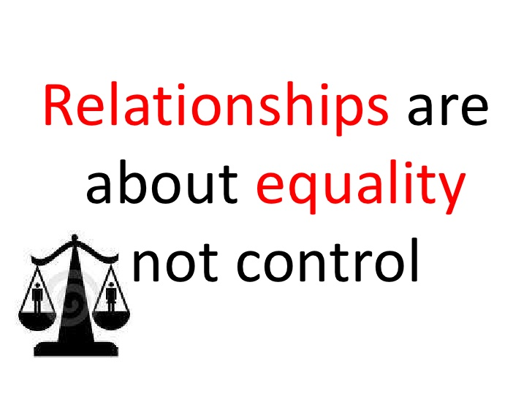

Slide 18
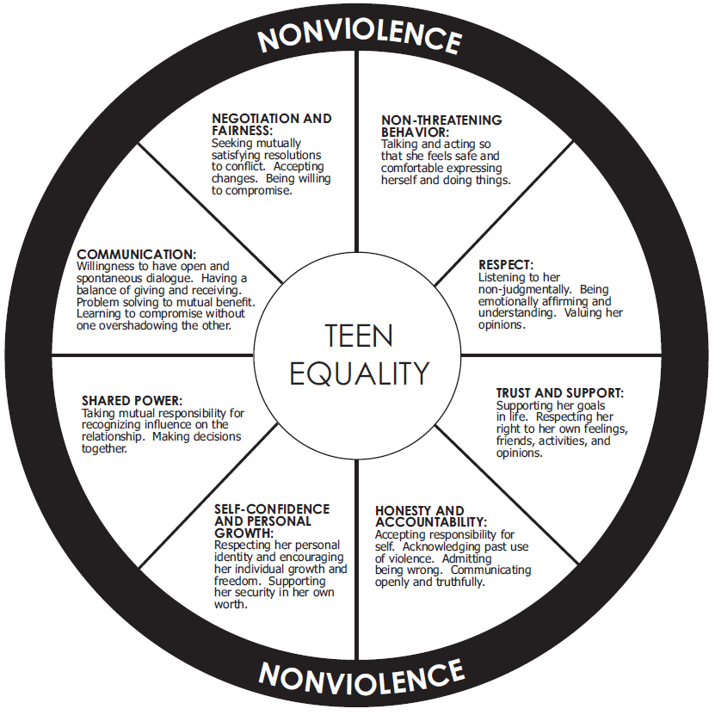

Slide 19


Healthy Relationship Green Flags
Your partner treats you with RESPECT & DIGNITY & like an EQUAL
Trusts you
Is honest and open with respectful communication.
Listens and tries to understand you
Asks for your opinion, values your input

Slide 20

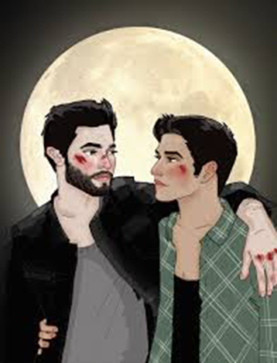
MORE GREEN FLAGS:
Shares decisions is willing to make healthy compromises
      Takes responsibility for his or her own actions
      Respects your right to say “NO” to sex, drugs, or other things you think are wrong or simply do not want to do.

Slide 21


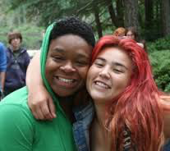
A healthy Relationship makes you feel…
SAFE (all of the time)
RESPECTED (all of the time)
Good about yourself
Cared about
Heard/listened to

Slide 22
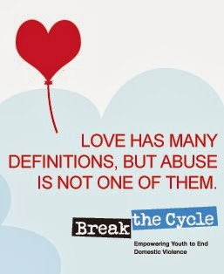
UNHEALTHY RELATIONSHIPS AND/OR DATING ABUSE
includes more than just obvious behavior like hitting . It includes verbal, emotional, sexual, financial, and technological abuse
Remember, not all difficult or painful experiences are abuse, for instance, when someone tells you she or he is upset, or wants to break up.

Slide 23
BEHAVIORS ARE ABUSIVE WHEN...
They’re used to gain CONTROL and POWER over someone in a dating or intimate relationship.
They make you feel bad about yourself or others you’re close to
They make you AFRAID of your dating partner
(Foshee & Langwick, 2010)

Slide 24
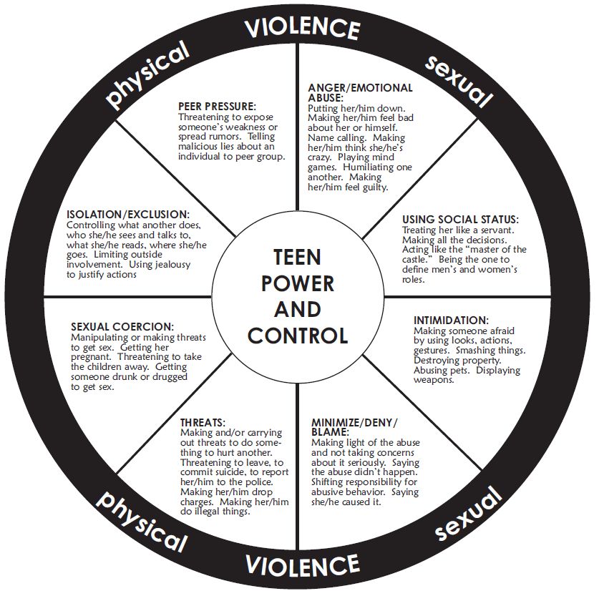

Slide 25
Teens are still learning about relationships
If you haven’t had a lot of dating experience, you might not recognize some unhealthy behaviors…
Jealousy | → | “He (or She) loves me so much, he (ir she) can’t stand to think of me with other guys (or girls)”
Possessiveness | → | “He (or She) is just being protective”
Controlling | → | “He (or she) cares about me and wants the best for me”
Stalking/ Harassment | → | “He (or She)must love me, he can’t stop thinking about me and texting me”

Slide 26

What are some signs, “Red Flags,” that a relationship may be “UNHEALTHY”?

Slide 27
But they were so nice in the beginning….!
Teens who end up being abusive often start out being very nice, attentive, charming, romantic…. but then “RED FLAGS” begin to crop up over time.

Slide 28

The other person:
Physically hurts or threatens you in any way
Tries to CONTROL what you do, whom you see, what you wear, etc.
Bullies you
Has an explosive temper
Makes you FEEL AFRAID
Puts you down trying to make you feel badly about yourself.
Calls you names or yells at you

Slide 29
The other person:
Does/says things to embarrass or humiliate or shame you alone or in front of others
Talks trash about you behind your back/tries to ruin your reputation
Tells your secrets to other people
Is very jealous or accuses you of things you didn’t do
Tries to ISOLATE you from family/friends/school

Slide 30
The other person:
Repeatedly pressures you to have sex or expects sex in return for spending money on you
Always blames you when things go wrong
Blames you for choices they make
Tries to make you feel guilty a lot
Pressures you to do things you think are wrong, e.g., using drugs/getting drugs for him or her

Slide 31
The other person:
Spies on you
Stalks you/ “pops up” when you don’t expect to check up on you
Says he or she can’t live without you
Says they’re going to hurt themselves or you or someone else if you don’t do what they want or try to leave him/her (VERY DANGEROUS).

Slide 32
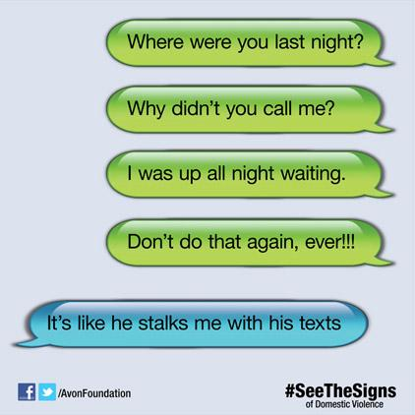
The other person:
monitors your cell phone /computer activity
spreads rumors about you online or through texts
threatens to share or shares private or embarrassing photos of you
sends insults
Notes:
Abusers may use technology to control and keep tabs on their victims.
Example: Making you give him your password to Facebook so he can see who you’re talking to.

Slide 33
An unhealthy relationship can make you feel…
Alone
Anxious
Worried
Stressed out
Afraid
Depressed
Upset
Angry
Frightened
Tense
Nervous
Confused
Like it’s hard to trust people
Ashamed
Guilty
Inferior
Dumb
Ugly
Fat
Stupid
Like it’s always your fault whenever the other person gets upset
Like you don’t deserve any better

Slide 34

“SORRY IS NOT ENOUGH”

Slide 35
“SORRY IS NOT ENOUGH”
Sometimes one incident of something is enough to end a relationship, for instance, physically hurting or threatening to hurt you, someone you care about, or themselves in any way, or forcing sex on you.
Other times if something happens once, the person needs to take responsibility for the behavior and actually change it. If it happens again, it’s likely to get worse.

Slide 36
NPR: This American Life
Act I: “I can explain.”
A story of teen dating violence as told primarily by the teenage survivor.
Starts at 10’18” into the show and ends at about 40”23.”
http://www.thisamericanlife.org/radio-archives/episode/567/whats-going-on-in-there

Slide 37
How to handle non-violent red flags early on…
First, make sure you are safe.
Inform him or her that you do not want that kind of behavior or relationship and tell him or her what kind of behavior you expect.
If you’re the other person continues that or some other unhealthy behavior, it’s another RED FLAG that you will continue to be mistreated.

Slide 38
ENDING A RELATIONSHIP SAFELY
The longer you wait, the longer the abuse goes on, the the more difficult it can be to get out.
If you decide to end the relationship, use the SAFETY PLANNING guides available in the handouts and on the Child Abuse Council Website because leaving can potentially be the most dangerous time.

Slide 39
Abuse: it can last a lifetime…
__________________________________________________________________________
Intimate Partner Violence
Bullying
Teen dating violence
Elder Abuse

Slide 40
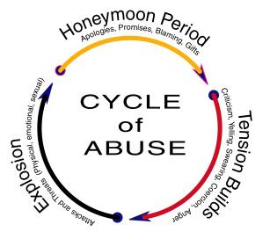

Slide 41
Why do you think people stay in abusive relationships?
Here are just some of the reasons.

Slide 42
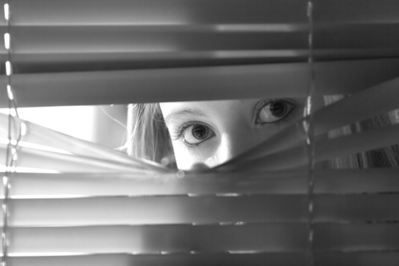
“Who would have believed me?”
“I didn’t want to tell any of my friends what my boyfriend was really like. Who would have believed me? I was supposed to be smart, and smart people don’t get into abusive relationships, do they? So I said everything was okay. Great, even. I talked about all his good qualities and hid the bad ones.
Even if they did believe me, I didn’t want anybody to think I was dumb for not leaving him. I didn’t want them to ask me how I got into this in the first place, because the truth was that I didn’t know. It would probably seem so obvious to them, and I’d feel so embarrassed that I hadn’t seen the signs.”

Slide 43
WHY DO PEOPLE STAY IN ABUSIVE RELATIONSHIPS?
Leaving is not always easy...
Sometimes people don’t even realize they’re being abused because they have learned that this kind of treatment is normal, OK, and should be expected.

Slide 44

WHY DO PEOPLE STAY IN ABUSIVE RELATIONSHIPS?
Sometimes the abusive person is like Dr. Jekyll, very nice, especially at first and in front of others. Then he or she turns into Mr. or Ms. Hyde, mean and cruel, often in private. So the mistreated person feels that no one will believe him or her about the abuse.

Slide 45
WHY DO PEOPLE STAY IN ABUSIVE RELATIONSHIPS?
Often the person who is doing the mistreatment blames the mistreated person for causing it and says that if the “victim” would only change, he or she wouldn’t hit or be mean etc. So the mistreated person comes to believe if only, for instance, she would change, he wouldn’t be so mean. But that’s just not true because it’s the person behaving abusively who has the problem.

Slide 46
WHY DO PEOPLE STAY IN ABUSIVE RELATIONSHIPS?
Love! And because they think they can change the other person. i.e., that if they just figure out what the other person wants and act that way, the other person will stop being mean and just be nice.
They love Dr. Jekyll, and just want him. But they don’t really have the power to get rid of Mr. Hyde. Only the other person can control Mr. Hyde, and sometimes they never do.

Slide 47

WHY DO PEOPLE STAY IN ABUSIVE RELATIONSHIPS?
The teen may feel sorry for the other wanting to help with his/her problems not realizing that the teen is powerless to change the partner’s abusive behavior.

Slide 48


WHY DO PEOPLE STAY IN ABUSIVE RELATIONSHIPS?
FEAR
That the other person will hurt her or him, hurt themselves, or someone else
That the other person or their friendswill seek revenge and/or try and ruin her or his reputation or embarrass him or her; loss of social status
Of hurting the other person’s feelings
Of being alone, lonely, single

Slide 49
What to do?
What are some things you can say or do to handle red flags early on?
What works?
What’s helpful?

Slide 50

How to handle red flags early on…
The earlier you set limits, the better chance you have of changing the behavior or getting out safely.
Things you can do…
Say how you feel. Ex: “When you raise your voice to me, it makes me feel scared.” Instead of “Stop being a jerk.”
“When you try to tell me what to wear, it makes me feel like my opinion doesn’t matter.”
“I can’t answer that right now. I need time to think.”
Talk with responsible and trusted friends and adults for feedback.
Break up SAFELY if necessary.

Slide 51
What can you do if you realize you are already in an abusive relationship?

Slide 52
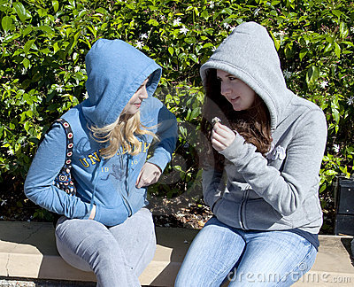
What if I think I’m being abused?
Tell someone!
Don’t stay silent!
Tell someone you trust.
It could be a friend or teacher, counselor or your parent.

Slide 53
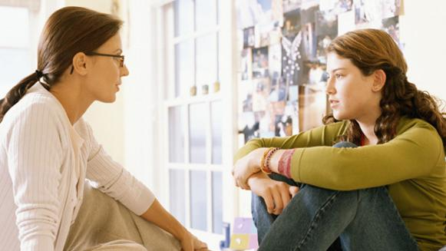
Who is safe to tell?
Adults you could tell:
Teachers
School counselors
Trusted relatives
Your parents (if you trust them)
Some adults like teachers and doctors are mandated reporters

Slide 54

Who not to tell
People who judge you for staying
People who don’t believe you
People who defend your partner or blame you
People who will report back to your partner

Slide 55
Safety first!
Leaving is one of the most dangerous times—very important NOT to discuss with your partner plans to leave—you risk physical injury or worse.

Slide 56
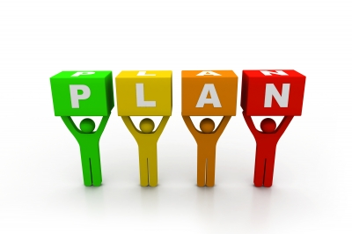
Have a safety plan:
Where can you go for help?
Who can you call?
Who can and will help you?
How will you escape if the situation becomes violent?
What can you do to make yourself safer?

Slide 57
Tips for creating a safety plan to leave an abuser…
If you live with your abuser, try to leave the house on a regular basis and maintain a daily routine – this will help you leave without drawing attention to yourself
Learn the best route to get to a safe location in times of an emergency
Remember, you have needs too--take care of them!
Don’t stay in an abusive relationship to “protect” your partner
If you need a place to stay, contact the National Teen Dating Abuse helpline at 866-331-9474

Slide 58
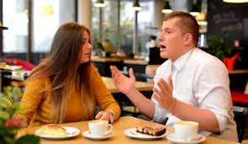
PLEASE REMEMBER
You cannot change your partner’s abusive behavior, only he or she can.
Try not to be alone with your abuser if they have a tendency to get violent
Don’t be alone with him or her when you are breaking up if you think it could be dangerous (ex: meet in a public place)

Slide 59

More tips…
Keep a private journal of your experiences that your partner can’t find
Keep cell phone charged for emergencies—it’s a felony to prevent someone from calling 9-1-1
Keep items you might need to take with you ready: cash, I.D., keys
Notes:
Other suggestions:
•Keep an emergency stash of money in case you need to get transportation to a safe place
•Have a code word you share with a few trusted people that will let them know you’re in trouble without tipping off the abuser

Slide 60
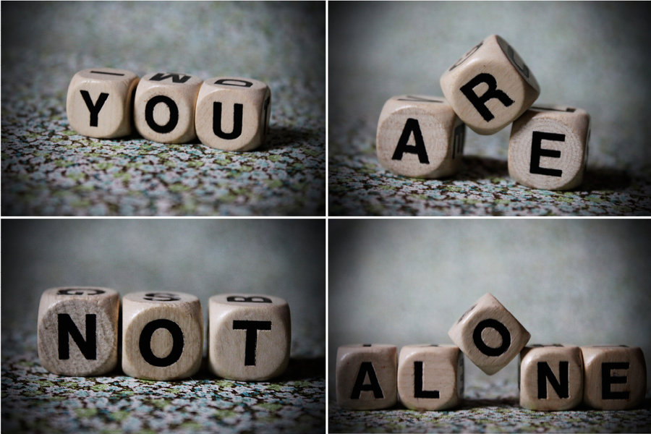
Remember...
If you’re being abused:
Many others have experienced the same things as you, you don’t have to feel like you’re alone.
Abuse is NEVER your fault.

Slide 61
What if my friend is being abused?
What could you do if you thought your friend was being abused?
(Hints: What do you say to them? Should you ever tell an adult? When would it be appropriate?)

Slide 62

If your friend is being abused…
Be supportive and nonjudgmental
Don’t push advice onto your friend
Encourage your friend to be open with you

Slide 63
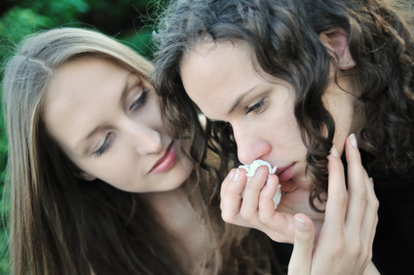
If your friend is being abused…
Be gentle with your friend. Getting frustrated with them for not leaving will only make them feel worse, not convince them to leave.
Express concern, but not judgement, anger, frustration, rejection – or they just won’t tell you the next time and they will become more isolated.

Slide 64
Things you can say
“I’m concerned for your safety”
“I’m concerned it’ll only get worse”
“You’re not alone, I’m here for you”
“You don’t deserve to be treated this way, no one does”
“It’s not your fault”

Slide 65
If you feel you cannot tell an adult…
Educate your friend on teen dating violence
Give your friend resources (e.g. websites, books, hotline phone numbers, handouts that we have here today)

Slide 66
Conclusion
Dating violence comes in many forms, including physical, emotional, sexual, financial and technological
Watch out for red flags that may signal abuse
Abusers can alternate between being affectionate and abusive
Healthy relationships involve mutual support, trust, shared power, and feeling loved, respected and safe
If you suspect you or someone you know is in an abusive situation, try to get help from trustworthy sources

Slide 67
Conclusion
Be supportive of friends, not judgmental
Even if you grew up in a violent home you can choose a different path
You can choose to treat your partner the way you wish you had been treated
You have a right to be treated well in any relationship
You deserve to live in peace, safety, and freedom in your own home!
BE SAFE AND ENCOURAGE OTHERS TO BE SAFE.

Slide 68

WE GET IT!
If you are experiencing dating violence, or know someone who is,
there is help available!

Slide 69
Thanks to all those who helped organize and produce this symposium this PowerPoint, and the handout materials.
The written information presented on the PowerPoint was taken from the following resources and others located on the website for the Child Abuse Council of Santa Clara County at: https://www.sccgov.org/sites/cac/Pages/cac.aspx

Slide 70
Resources
The National Domestic Abuse Hotline:
Offers 24-hour help by online chat (at loveisrespect.org)
  Text (text "loveis" to 22522)
Phone (1-866-331-9474)
Aimed at young people of all genders
Abused girls may be more willing to seek help. There's a lot of stigma about boys and men reaching out when they are victims. Don’t let that stop you from getting help!

Slide 71
Resources
LoveIsRespect.org
1-866-331-9474
Text “loveis” to 22522
http://www.loveisrespect.org/
The National Domestic Violence Hotline
1-800-799-7233
http://www.thehotline.org/
Chat 4 Teens
http://www.billwilsoncenter.org/teens/chat4teens.html
National Sexual Assault Hotline
1-800-656-HOPE (4673)
National Sexual Violence Resource Center
www.nsvrc.org
Peace-It-Together
408-744-1009
info@peace-it-together.org
Bill Wilson 24/7 Youth Hotline at (888) 247-7717 to speak with a counselor over the phone.

Slide 72
Resources
Community Health Awareness Council
(CHAC)
(650)965-2020
http://www.chacmv.org/
Bill Wilson Center
(408) 243-0222
http://www.billwilsoncenter.org/services/services_for_teens.html
Family & Children Services
(408)292-9353
http://www.fcservices.org/
LGBT resources
Family & Children Services LGBTQ Youth Space Program
(408)343-7940
http://www.fcservices.org/lgbtq-youth-space-program/
Outlet
http://www.chacmv.org/?page_id=575
Trevor Project Lifeline
1-866-488-7386

Slide 73
Resources
National Center for Victims of Crime: Stalking
http://www.victimsofcrime.org/help-for-crime-victims/get-help-bulletins-for-crime-victims/bulletins-for-teens/stalking
Adolescent Counseling Services (ACS)
http://www.acs-teens.org
California Youth Crisis Line
1-800-843-5200
http://www.youthcrisisline.org

Slide 74
Acknowledgement
WomenSV@DVIC
Ruth Patrick, M.A., Director
rpatrick@dvintervention.org
For her assistance in the preparation of this powerpoint.

